Slide 1
Prediction of disease from symptoms
SheCode
IEEE CIS , GHRCE

Slide 2
Developed by
Priyal Gandhi -Team Lead
Banugaria Dhruvita
Shivani Rajput
Riya Tyagi

Slide 3
INTRODUCTION :
The healthcare domain is one of the prominent research fields in the current scenario and the rapid improvement of technology and data.
It is quite difficult to handle the large amount of data of disease its symptoms, precautions and medication to be used.

Slide 4
Project Description :
This project depicts the prediction of disease based on symptoms using machine learning.
Its implementation is done through the python programming language.
The research demonstrates the best algorithm based on their accuracy.
The accuracy is determined by the performance on the given dataset.

Slide 5
Need for such a Model :
Nowadays,people face various disease due to the environmental conditions and their living habits.
So the prediction of disease at the earlier stage became important task and helpful to an individual.
But the accurate prediction on the basis of symptoms became too difficult for the doctor.Multiple, non interrelated disease may have same symptoms.The correct prediction of disease is the most difficult task.

Slide 6
About our Model :
We proposed general disease prediction based on symptoms of the patient. For the disease prediction, we use Multinomial Bayes Classification for accurate prediction of disease. For disease prediction require symptoms dataset.
The accuracy of general disease is 99%
After general disease prediction, this system able to gives the risk associated with general disease which is lower risk of general disease or higher.

Slide 7
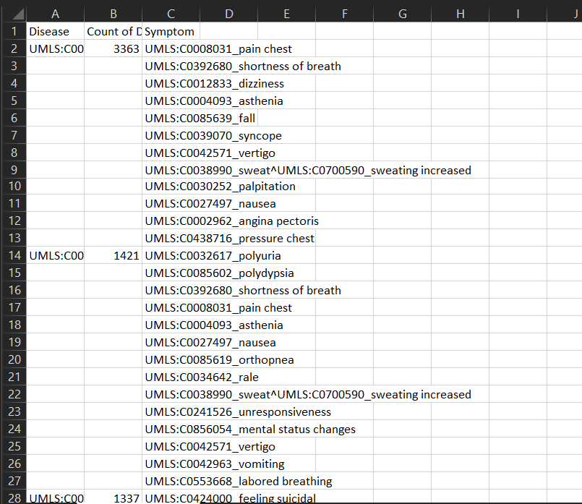
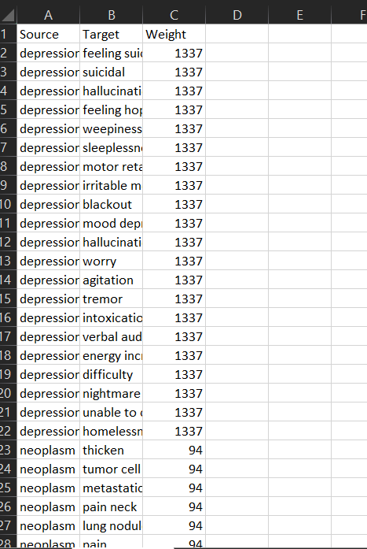
Datasets Review :
Unclean Dataset
Clean Dataset

Slide 8
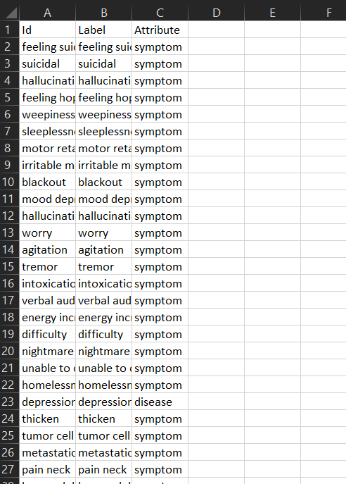
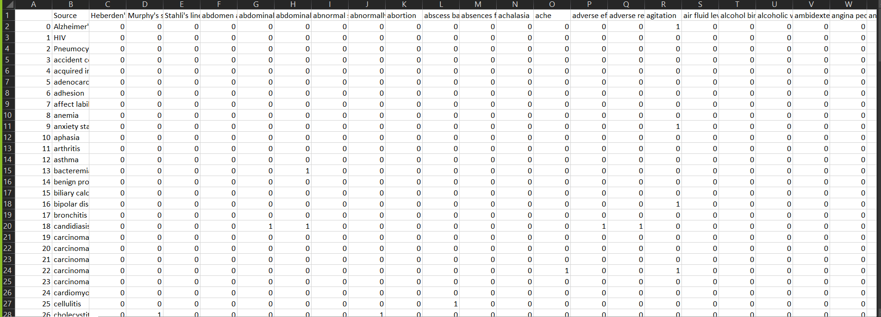
Implementation :
Node Data Set
Pivoted Dataset for getting values of x and y

Slide 9
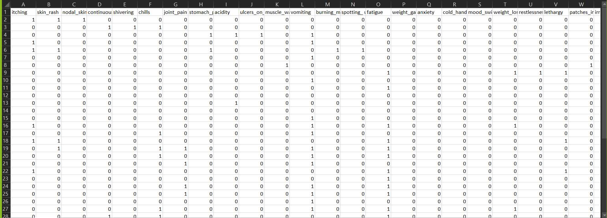
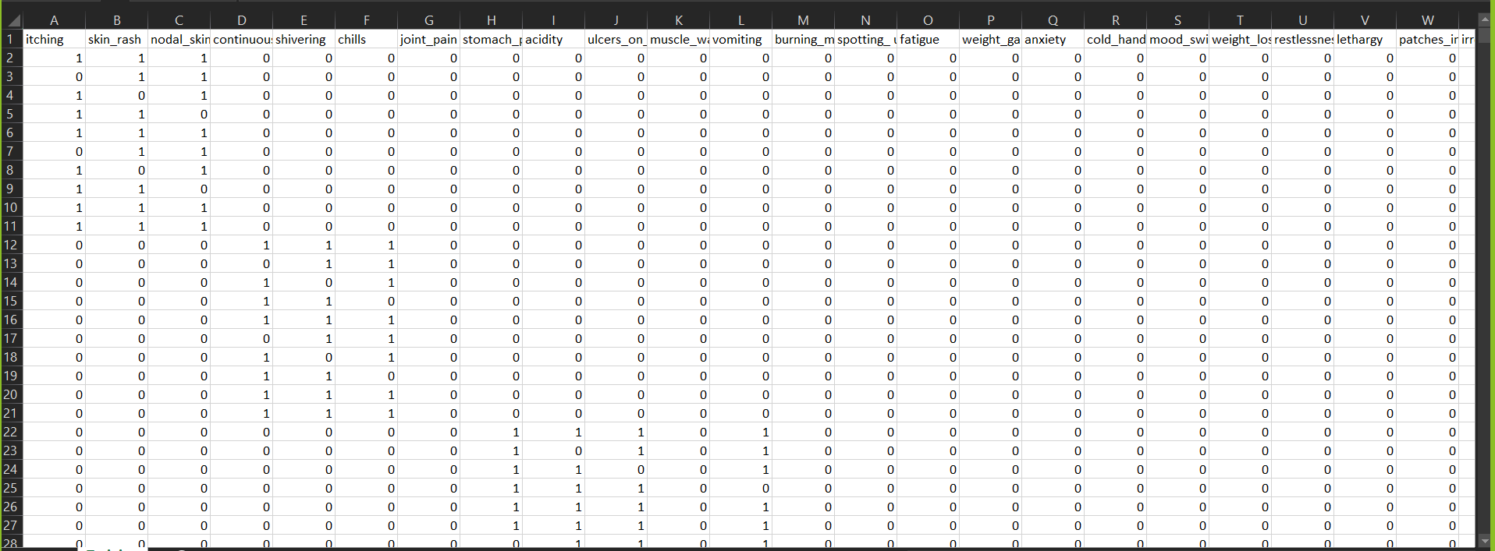
To Train and Analyse The Model :
Train and Test Dataset

Slide 10
Conclusion :
We implemented Prediction of Disease from Symptoms with accuracy 1.0 using Multinominal bayes Classification in Machine Learning.
In future we can create an Mobile Application/website so that an individual can enter their symptoms and get the result as what disease they are probably suffering.
For Code and dataset refer :
Repository : https://github.com/SheCodes-IEEE-CIS-GHRCE/Medical-Diagnosis-Prediction-of-disease-from-symptoms.-

